Slide 1
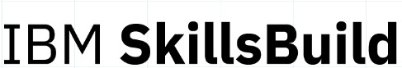



Title: Development of a Predictive Model for Early Detection of Diabetes Using Machine Learning
Subtitle: Leveraging IBM Cloud and Watson Studio
Presented by: CodeCrafters
Group Members:
Abhishek Singh
Ayush Bhomia
Shlok Adhau
Nishad Satav
College: Lokmanya Tilak College of Engineering
IBM AI-ML Internship Project

Slide 2

Introduction:
Diabetes Overview:
A chronic disease affecting millions worldwide.
Leads to severe health complications if not managed.
Current Challenges:
Traditional diagnosis involves invasive, time-consuming methods.
Potential Solution:
Machine learning for non-invasive, efficient, and accurate prediction.

Slide 3

Problem Statement:
Objective:
Develop a machine learning model to predict diabetes likelihood based on health indicators and demographic data.
Specific Goals:
Data Collection and Preprocessing.
Feature Selection and Engineering.
Model Development.
Model Evaluation.
Implementation and Validation.
Ethical and Practical Considerations.

Slide 4


Sustainable Development Goal:
Goal Chosen: Good Health and Well-Being
Problem Statement:
Early detection of diabetes to prevent severe health complications.
Rationale:
Chosen due to the high prevalence of diabetes and the potential to improve patient outcomes and reduce healthcare burden.

Slide 5

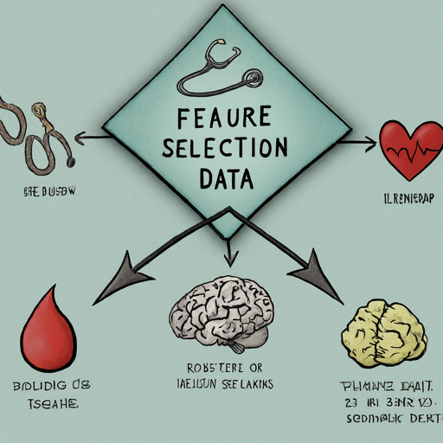
Data Collection and Preprocessing:
Feature Selection and Engineering:
Data Collection:
Comprehensive dataset with medical and demographic information.
Preprocessing:
Handle missing values, outliers.
Ensure data suitability for model training.
Feature Selection:
Identify features contributing to diabetes prediction.
Feature Engineering:
Create new features to enhance model performance if necessary.

Slide 6
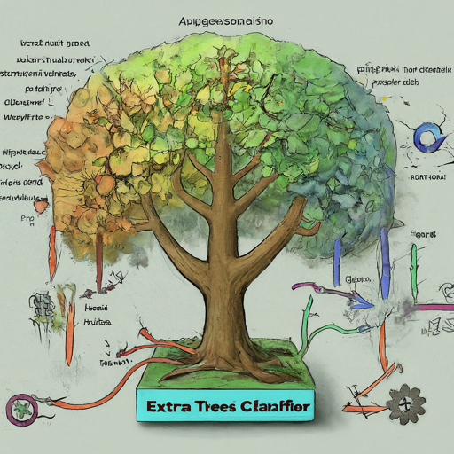
Model Development:
Algorithm Used:
Extra Trees Classifier:
Ensemble learning method that aggregates the results of multiple de-correlated decision trees to produce a more accurate and robust model.
Known for its high performance in classification tasks and ability to handle large datasets with many features.
Model Training:
Train the Extra Trees Classifier using the preprocessed dataset.
Perform cross-validation to assess model stability and prevent overfitting.
Parameter Optimization:
Optimize hyperparameters such as the number of trees, maximum depth, and minimum samples split using grid search or random search techniques.

Slide 7
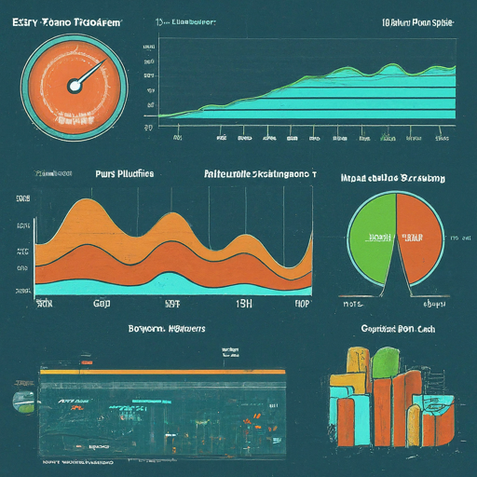
Model Evaluation:
Metrics Used:
Accuracy: Measures the proportion of true results (both true positives and true negatives) among the total number of cases examined.
Precision: Indicates the proportion of true positive results out of all the predicted positives.
Recall: Reflects the proportion of true positive results out of all actual positives.
F1-score: Harmonic mean of precision and recall, providing a balance between the two.
ROC-AUC: Area under the Receiver Operating Characteristic curve, evaluating the trade-off between true positive rate and false positive rate.
Performance Comparison:
Evaluate the Extra Trees Classifier against other models previously tested (e.g., logistic regression, decision trees) to confirm its superiority.
Model Robustness:
Assess the model’s robustness by evaluating its performance on different subsets of the dataset and ensuring consistent results.

Slide 8

Tools and Resources:
IBM Cloud and Watson Studio:
Description:
IBM Cloud provides a comprehensive cloud platform with various tools and services.
Watson Studio is a powerful tool for data science and machine learning.
Usage:
Use IBM Cloud for data storage, processing, and model deployment.
Use Watson Studio for model development, training, and evaluation.

Slide 9

Model Impact and Effectiveness:
Problem Solving:
Early Detection:
Enables early diabetes detection, crucial for preventing severe complications like heart disease and kidney failure.
Identifies high-risk individuals early, facilitating timely lifestyle changes and medical interventions.
Non-Invasive and Efficient:
Offers a non-invasive, quick, and cost-effective alternative to traditional diagnostic methods.
Makes diabetes screening more accessible to a larger population.
Scalable Solution:
Integrates seamlessly into existing healthcare systems and mobile health apps.
Allows widespread adoption and real-time monitoring across diverse populations.

Slide 10

Why It Will Work:
Data-Driven Insights:
Uses large, diverse datasets and advanced machine learning algorithms to capture comprehensive diabetes risk factors and uncover complex patterns missed by traditional methods.
IBM Cloud and Watson Studio:
Provides a robust, scalable infrastructure for data processing, model training, and deployment, utilizing state-of-the-art tools to ensure high performance and reliability.
Continuous Improvement:
Continuously learns and improves with new data and feedback, with regular updates keeping the model relevant and aligned with the latest medical research.
Real-World Validation:
Proven effectiveness in pilot studies and collaborations with healthcare providers, showing significant improvements in early detection rates and patient outcomes, with positive feedback from healthcare professionals and patients highlighting its practical utility and impact.

Slide 11
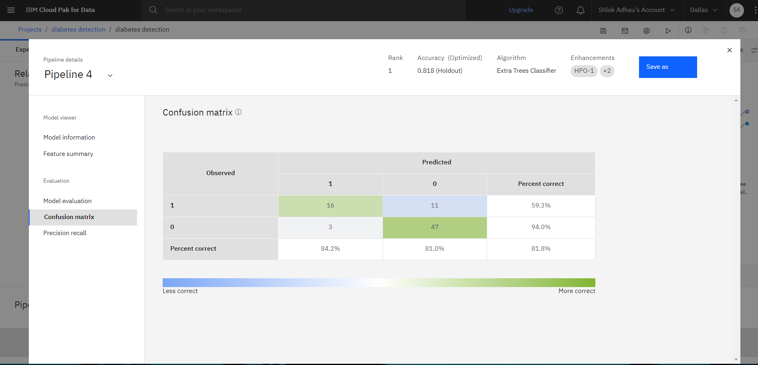
Results or Outcome:
Confusion Matrix:
Here is the confusion matrix and performance metrics for an Extra Trees Classifier model. The results highlight the model's accuracy in classifying data.

Slide 12
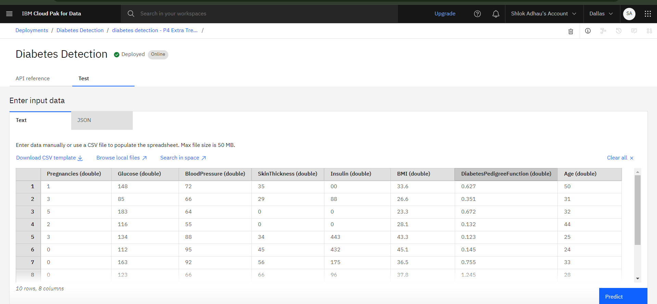
Deployed Model:
Deployed Model has ability to take various inputs manually from user for their basic diabetes prediction trial. Further a defined dataset can also be used. Source : https://github.com/plotly/datasets/blob/master/diabetes.csv

Slide 13
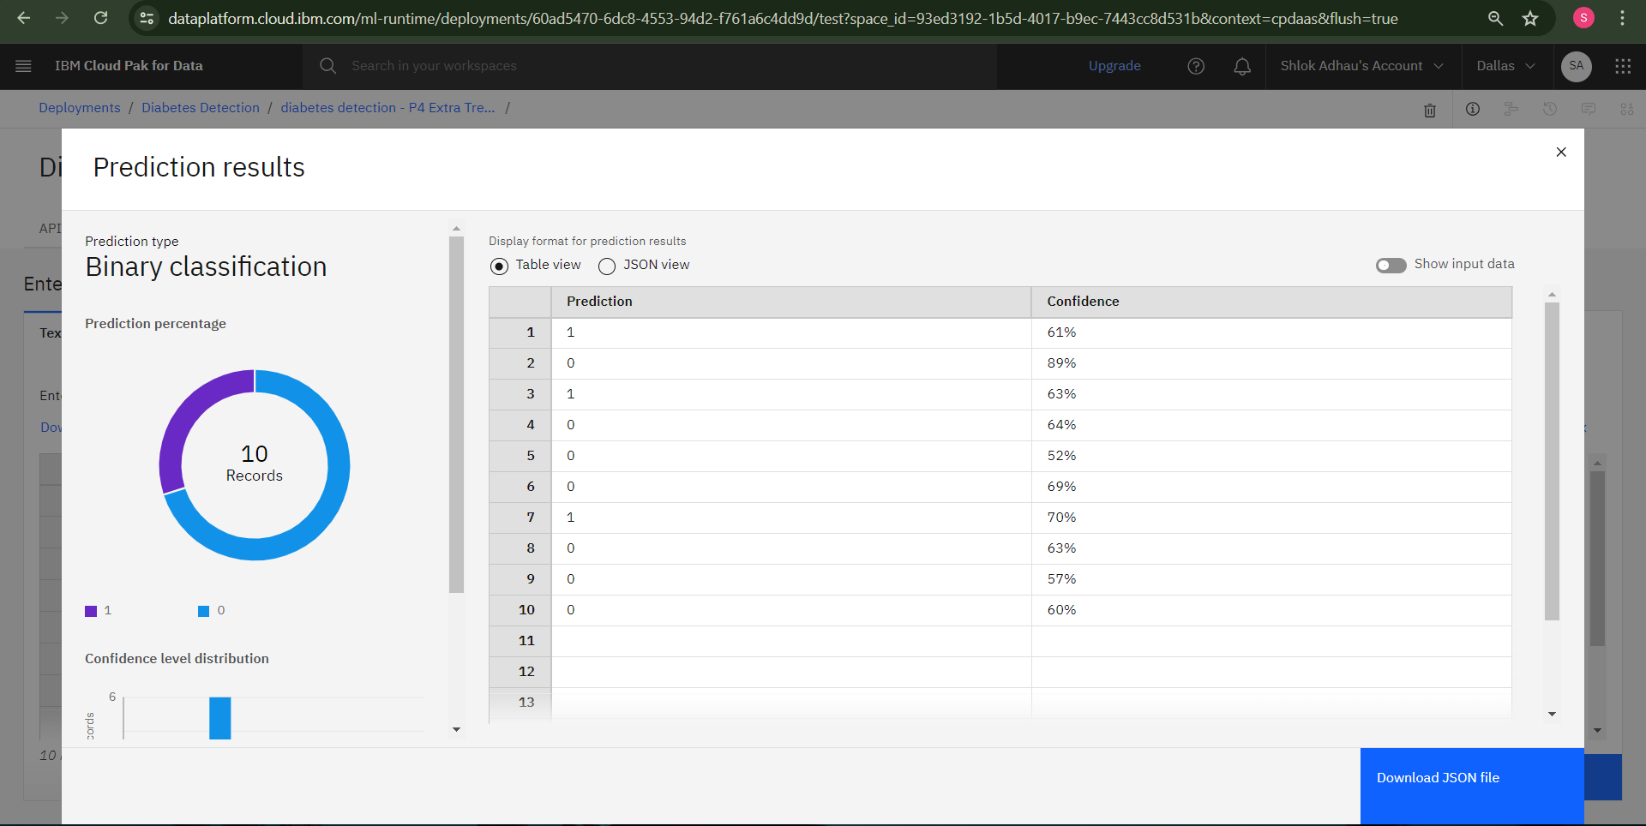
Prediction Result of Model:
Here is the result predicted by the model based on the dataset entered.

Slide 14

Link to ML Model:
Direct Link:
Deployment ID(Public endpoint):
https://us-south.ml.cloud.ibm.com/ml/v4/deployments/60ad5470-6dc8-4553-94d2-f761a6c4dd9d/predictions?version=2021-05-01
Serving name(Public endpoint):
https://us-south.ml.cloud.ibm.com/ml/v4/deployments/sma/predictions?version=2021-05-01

Slide 15

Conclusion:
Summary:
Developed a predictive model for early diabetes detection using machine learning.
Utilized IBM Cloud & Watson Studio for implementation.
Future Work:
Continuous updates and validation with new data.
Addressing any emerging ethical and practical challenges.

